Slide 1
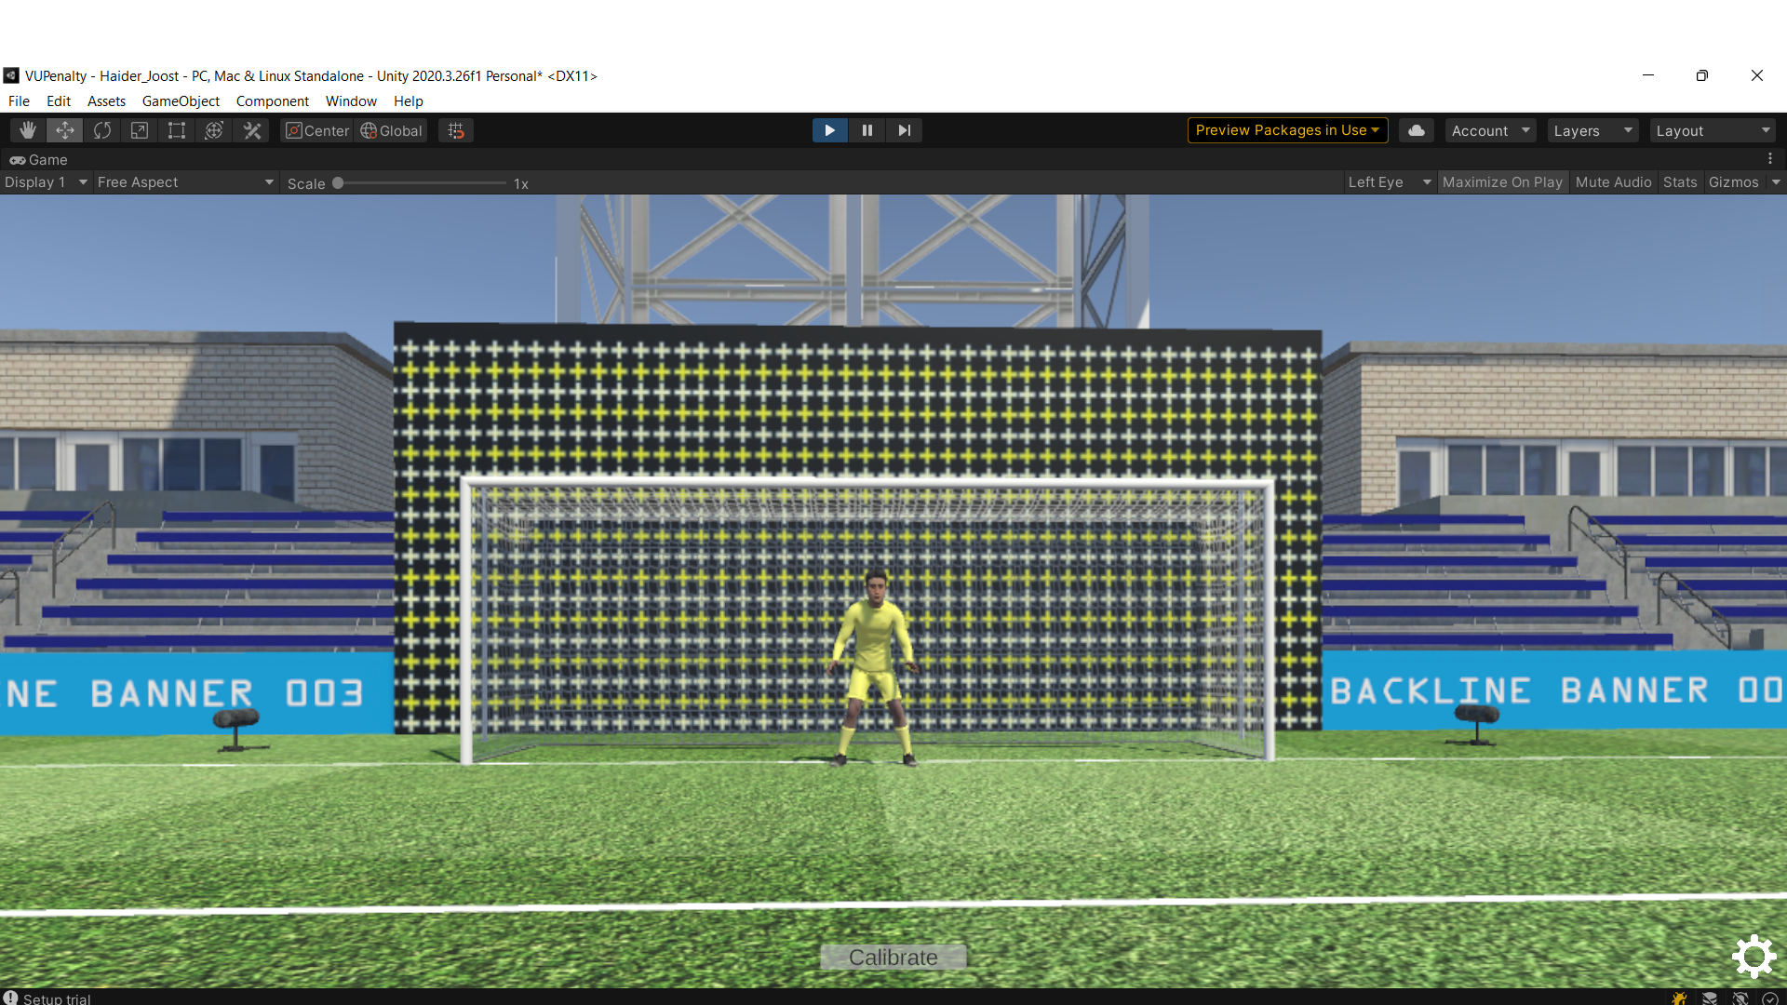



Advertisement moves to the right
Keeper moves to left

Slide 2
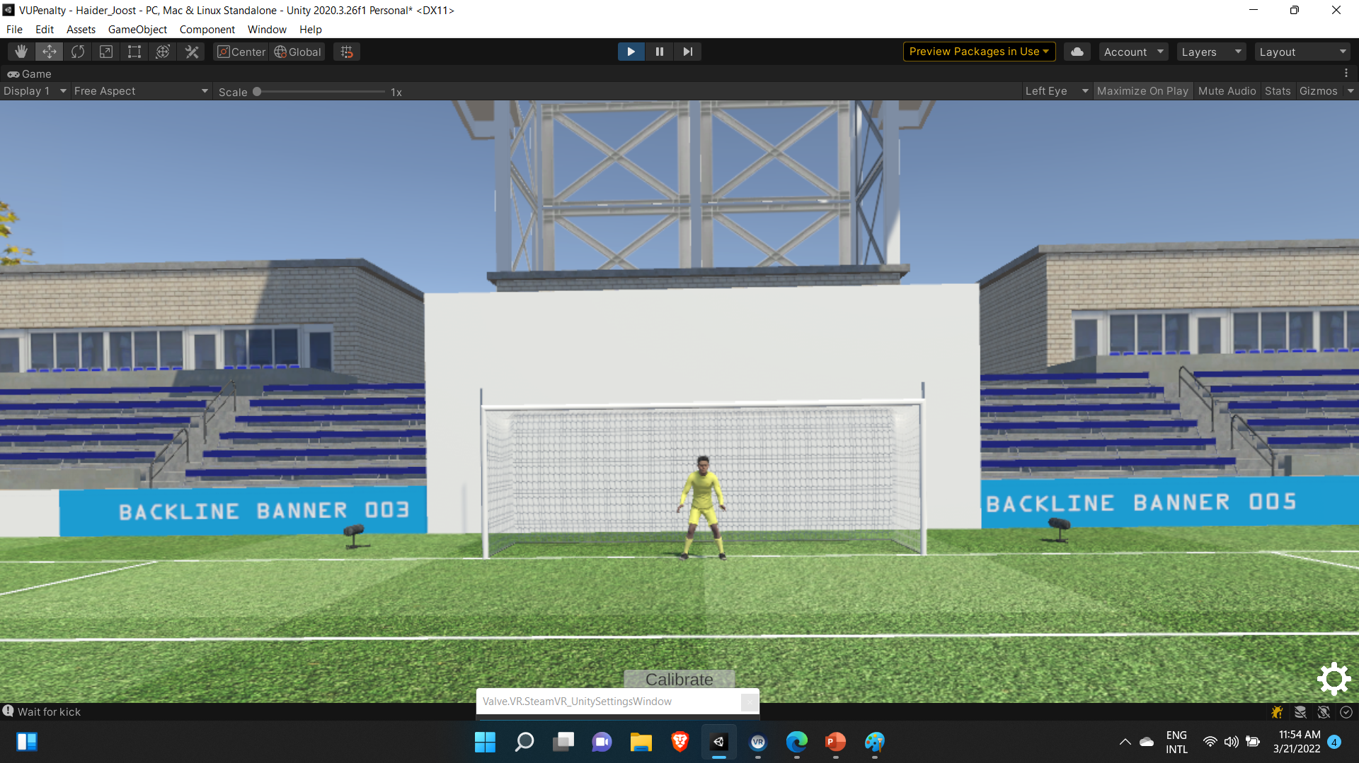
12,0 m
7,32 m
5,0 m
2,44 m

